Slide 1
Compilation, Codification, and Some Thoughts on What It All Might Mean
Lecture 5

Slide 2

Pre-Justinianic Collections: Problems with Constitutions
367
287
138
240
0
100

Slide 3
Pre-Justinianic Collections
(edictum perpetuum: c. AD 130)
Private unofficial collections:
Codex Gregorianus (AD 291)
Codex Hermogenianus (c. AD 295)
Theodosian Code (AD 438) + novellae
Marble bust of Theodosius II, 5th century AD (Louvre)
Notes:
Bust: https://en.wikipedia.org/wiki/Codex_Theodosianus#/media/File:Theodosius_II_Louvre_Ma1036.jpg

Slide 4
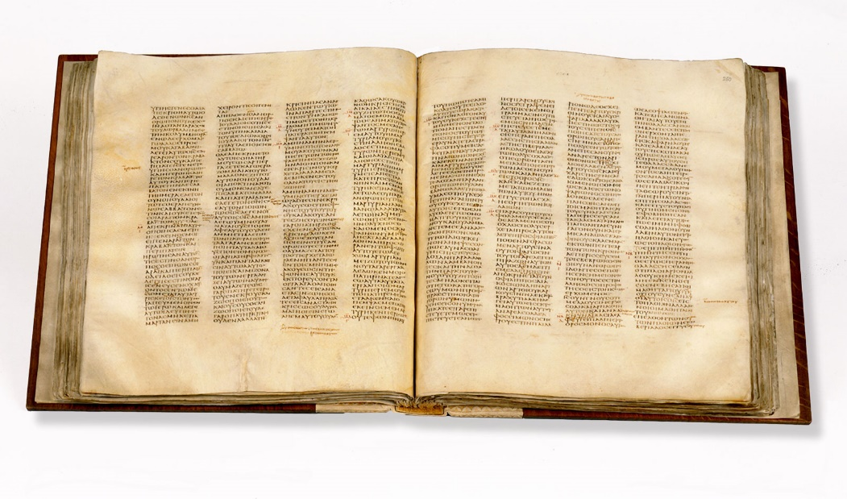

Codex and Liber
Codex Sinaticus, mid-4th century Greek ms. of the Christian Bible, now mostly in the British Library (Encyclopedia Britannica)
Papyrus roll from Herculaneum, 70 AD (Getty images)
Notes:
Bust: https://en.wikipedia.org/wiki/Codex_Theodosianus#/media/File:Theodosius_II_Louvre_Ma1036.jpg

Slide 5
The Theodosian Code
In 429, Theodosius II appointed a commission to collect imperial constitutions with a general significance and all ius et leges as well, but only the collection of constitutions was completed. It was finished in 438, made effective 1 Jan. 439.
The constitutions in the CTh begin with Constantine and are given in chronological order without taking into account later repealers and amendments.
Probably about a half of it has survived.
It was valid in the Germanic kingdoms of the West.
The medieval pays de droit écrit, the ‘land of written law’, roughly the southern third of France.

Slide 6
The Making of the Corpus Iuris Civilis
527: Justinian becomes emperor
529: the “first” Code
529–34: the “fifty decisions”
530–33: Digest
533: Institutes
534: Codex Iustinianus
after 565: the Novels (168 of them)
Justinian I, detail of a 6th-century mosaic at the church of San Vitale, Ravenna

Slide 7
529: The ‘first’ Code
Early in 528, Justinian appointed a commission of ten men to produce a Code. They began with the Theodosian Code, the Codex Gregorianus, and the Codex Hermogenianus, and produced a Code in twelve books to replace them all. This Codex was published in April 529. It has not survived.

Slide 8
530–533: The Digest (Pandects)
In December of 530, Justinian appointed a commission of seventeen jurists, headed by his quaestor Tribonian, to undertake a much more ambitious project: to compile a collection in fifty books of extracts from the classical jurists. The commission proceeded remarkably quickly, and Justinian’s Digest or Pandects was published in December of 533.

Slide 9
533: The Institutes
In December of 533, Justinian published a volume Institutes, based on Gaius’ Institutes, an elementary textbook, like Gaius’, in four books.

Slide 10
529–534: The ‘Fifty Decisions’ and the Second Code
Between 529 and 534, Justinian rendered a number of decisions, sometimes called ‘the fifty decisions’, to resolve the controversies among the jurists and abolish the out-of-date institutions. These decisions have not survived as such, but they were incorporated in a revised version of the Code, published in November of 534, which has survived.

Slide 11
Justinian’s Codification: Legal Force and Character
The Institutes, Digest, and Code were all authoritative. Justinian promulgated each of them as an imperial constitution.
The Digest and Code were also exclusive. No one was to cite juristic works or imperial constitutions that were not in the Digest or Code.
Justinian also prohibited commentaries on his own work. That proved to be ineffective, as the 60 books with scholiae of Greek Basilica of the 9th and 10th centuries shows.
The Institutes were not exclusive but they were systematic, as the other two were not.

Slide 12
Justinian’s Codification: Arrangement
The Digest and the Code are divided into books, 12 for the Code, 50 for the Digest.
There is some system in the arrangement of the books, particularly in the Code: Book 1 deals ecclesiastical material, courts and administration; books 2–8 with private law; book 9 with criminal law; books 10–12 with administrative law.
Each of the books is divided into titles, related to the topics of the books but with little system in their order within the book.
The extracts within each title are arranged chronologically by the date of the emperor who promulgated the constitution, beginning with Hadrian up to and including Justinian in 534.
The organization of the Digest will be treated in the next lecture.

Slide 13
Justinian’s Codification: ‘Interpolations’
In the case of both the Code and the Digest, the commissioners had the power to change, correct, and omit parts of the text in order to correct contradictions, mistakes, obscurities, bring the texts up-to-date in the light of current law, and simply to make them shorter. The key language in the commission for the Digest was essentially the same as that for the Code. (Too long to quote on a slide, the language may be found on the outline.)

Slide 14
Justinian’s Codification: ‘Interpolations’ Scholarship
That changes, ‘interpolations’, exist in the texts in the Digest and Code has been known since the humanists of the sixteenth century. Where interpolations can be spotted, they are valuable for legal history both for what they tell us about Byzantine law and for what they tell us about classical law. Over time scholarly consensus has varied as to how much interpolation there is, particularly in the Digest. Interpolation-criticism reached its height in the first half of the last century, when some scholars thought that many, perhaps a majority, of texts in the Digest had been mangled after they were written. These scholars sought to recover the core of what they thought of as ‘the true classical law’.

Slide 15
Justinian’s Codification: ‘Interpolations’ Scholarship (cont’d)
The scholarly tide has turned. Many scholars today would point to the fact that a relatively small group of men, who had other things to do, could not possibly have rewritten the very large number of texts in the Digest in the short space of time that they had. That does not, of course, exclude the possibility that the some of the texts that the commissioners were looking at had already been changed in the post-classical period, but the modern presumption is that the text is genuine unless there is a good reason to believe that it is not.

Slide 16
Justinian’s Codification: How to Find Interpolations
the Vatican Fragments, and
the Vatican Fragments, and
the Vatican Fragments, and
The most powerful evidence of interpolation is when we have a version of the text that antedates Justinian and says something different. There are not many such texts, but there are a few. In addition to an almost-complete version of Gaius’ Institutes, there are several post-classical works that antedate Justinian and contain texts or epitomes of, or references to, texts that are either also in Justinian or that imply a rule different from what we find in Justinian. These include:
the Opinions of Paul (Pauli Sententiae)
the Epitome of Ulpian (the so-called Regulae Ulpiani)
the Vatican Fragments
the Lex Dei (the ‘law of God’) aka Comparison of Mosaic and Roman Laws (Collatio legum Mosaicarum et Romanarum)

Slide 17
Justinian’s Codification: Interpolations – an Example
the Vatican Fragments, and
the Vatican Fragments, and
the Vatican Fragments, and
“[Julian] says that if a usufruct has been left by legacy to a slave who is owned in common and separately left to Titius, if the usufruct is lost by one of the common owners it does not go to Titius but ought to go to the other common owner, as he alone was conjoined in the grant: neither Marcellus nor Mauricianus approves this opinion; Papinian in Book 17 of his Problems also departs from it. Neratius’ view is given in book 1 of his Opinions. But I think [Julian’s] opinion is correct, for as long as one of the common owners uses it, it can be said that the usufruct subsists.” (Ulpian in D.7.2.1.2 and Fragmenta Vaticana 75.3)
Digest 7.2.1.2 is in Roman type. Fragmenta Vaticana has the same text with the additions in italic type. What was done here is probably typical of what the commissioners did elsewhere. A large variety of opinions on the topic was shortened, so that what remained was Julian’s opinion and Ulpian’s confirmation of it.

Slide 18
Justinian’s Codification: The Commissioners and the Code
the Vatican Fragments, and
the Vatican Fragments, and
the Vatican Fragments, and
What the commissioners did with the texts in Code is somewhat different. They divided the constitutions into parts and put each part under its proper title. In many cases that had already been done in the prior codes. Comparison with the Theodosian Code shows that the commissioners simply left out, for the most part, constitutions that had later been repealed or amended. They also, as had prior codifiers, left out the prefaces, a declaration of intention that appeared at the beginning of the constitution. Probably not all of them had such prefaces, but Justinian’s novels all do, and the price edict of Diocletian, which survives independently of the codes, also has one

Slide 19
Justinian’s Codification: The Novels
the Vatican Fragments, and
the Vatican Fragments, and
the Vatican Fragments, and
The commissioners finished their work in 534. Justinian reigned until 565. In the intervening years he issued many new constitutions (novellae). No collection of them was made in his own time. After his death, unofficial collections were made, the largest of which contains 168 constitutions. Some of these make important changes in the law. In the 16th century, Justinian’s own codifications, the Institutes, Digest, and Code, and his Novels acquired the generic name Corpus Iuris Civils, which has been used ever since.

Slide 20
Codification: Patterns and Significance
Beginning | End
Aethelberht (c. AD 600) | Uniform Commercial Code (1951)
Aethelberht of Kent, Canterbury Cathedral (1864)
Karl Llewellyn in his office at Columbia University
Notes:
Statue: Phyffers, Theodore. Aethelberht of Kent. 1864. Marble. Canterbury Cathedral. https://commons.wikimedia.org/wiki/File:Aethelberht_of_Kent_sculpture_on_Canterbury_Cathedral.jpg
Photograph: https://commons.wikimedia.org/wiki/File:Karl_Llewellyn.JPG

Slide 21
Codification: Patterns and Significance
Beginning | End
Aethelberht (c. AD 600) | Uniform Commercial Code (1951)
Salic law (c. AD 500) | Code Napoléon (1804)
Clovis I dictates the Salic Law (14th c.)
Napoleon, crowned by Time, Jean-Baptiste Mauzaisse (c. 1833)
Notes:
Miniature: Clovis I, the King of the Franks, in the midst of the Military Chiefs who formed his Treuste, or armed Court, dictates the Salic Law (Code of the Barbaric Laws). Facsimile of a Miniature in the "Chronicles of St. Denis," a Manuscript of the Fourteenth Century (Library of the Arsenal). https://commons.wikimedia.org/wiki/File:Salic_Law.png
Painting: Mauzaiise, Jean-Baptiste. Napoléon, couronné par le temps. c. 1833. Oil on canvas. Musée National du Château de Malmaison.

Slide 22
Codification: Patterns and Significance
Beginning | End
Aethelberht (c. AD 600) | Uniform Commercial Code (1951)
Salic law (c. AD 500) | Code Napoléon (1804)
XII Tables (c. 450 BC) | Justinian (533–34)
In each case we have at the beginning:
literacy, or at least the beginning of the use of writing for law
the beginning of professionalization
a realization of a connection between law and the ‘state’

Slide 23
Codification: Patterns and Significance
Beginning | End
Aethelberht (c. AD 600) | Uniform Commercial Code (1951)
Salic law (c. AD 500) | Code Napoléon (1804)
XII Tables (c. 450 BC) | Justinian (533–34)
In each case we have at the end:
a long period of professional development
sources becoming unmanageable
a powerful personality, perhaps of genius

Slide 24
Codification: Patterns and Significance
Whether it is possible to generalize about the early codes is a topic for the third part of the course, but the differences among the later ones are striking:
Justinian is a collection of texts; the UCC and the French Civil Code are systematic.
The politics seem to be similar between Justinian and Napoléon but not Karl Llewelyn, the draftsman of the UCC.
Justinian is legally conservative, Napoléon and Llewellyn much less so.
Conclusion: it is dangerous to see something too deep in the fact of codification itself.

Slide 25
A Theory of Legal Development?
A developmental theory of law is most firmly associated with Sir Henry Maine, the first edition of whose Ancient Law was published in 1861 (d. 1888). It is also firmly associatd with liberalism and with Darwinian ideas (though Maine wrote before Darwin). Let us review G.4.11–32, because what we are going to say about legal development generally depends on it. The focus here is on is Gaius’ attitude towards the movement from legis actio to formulary procedure.
Sir Henry Maine, Lowes Cato Dickinson (1888)

Slide 26
Legal Development: Back to Gaius (Institutes 4.11–32)
The legis actio was framed on the very words of the statutes (GI.4.11). Don’t take G. too literally here. Pomponius (D.1.2.2.6) is probably closer to right:
“Then from these statutes [XII Tables], at about the same time, actions were devised by which men might litigate, and lest these actions be indiscriminately brought by the people, they were required to be in certain and solemn form; and this part of the law is called legis actiones, that is, statutory actions. Accordingly, these three branches of law appeared at about the same time: the law of the Twelve Tables, from these came the ius civile, and from the same the legis actiones were devised. Moreover of all of these, both the science of interpretation and the (conduct of) actions were vested in the college of pontiffs, from among whom one was appointed each year to preside over private causes. And for nearly a hundred years the people conformed to this custom.” (Materials, p. 14)

Slide 27
Legal Development: Back to Gaius (Institutes 4.11–32) (cont’d)
The notion of sacramentum. For Gaius, it is a bet, similar to that made in the action for debt in his own day; the word, however, has decidedly religious connotations.
“I affirm that this man is mine by Quiritary right according to his proper title. As I have declared, so, look you, I have laid my staff on him.” (4.16) That is certainly a verbal formula, and it would seem that it had to be spoken exactly.
The legis actiones, Gaius tells us (4.11, 4.30), gradually became unpopular because of their excessive technicality.

Slide 28
Legal Development: Some Correlations
Changes in procedure and changes in sources of law are correlated with changes in the constitution. So far as sources of law are concerned that statement borders on tautology: king, pontiffs and magistrates; comitia and concilium; the senate; the emperor cannot be sources of law unless the constitution calls them into being. So far as procedure is concerned the relationship is more subtle but clearly there:
legis actio – magistrate, pontiff, private agreement
formulary – magistrate, judge, and jurist, proceedings in iure and apud iudicem
extraordinaria cognitio – increasing state power, the magistrate now summons, the execution is in state hands

Slide 29
Legal Development: Some Correlations (cont’d)
Changes and sources of law and changes in procedure are correlated with each other. This implies that law comes out of procedure. Some have denied that this is necessarily so, but. the realist rebuttal seems convincing. The formal sources of law do not necessarily reflect the relationship of substance and procedure, but they do in the case of the Romans:
legis actio – framing the actio, the pontiffs, despite what Gaius says about the statute
formulary – the praetor’s edict and the commentary of the jurists
extraordinaria cognitio – appeal or referral to the emperor and the rise of the imperial constitution

Slide 30
Legal Development: Some Correlations (cont’d)
Less certain: Changes in procedure and changes in sources of law are correlated with changes in society. Here too there is some tautology. A pontiff cannot be a source of law unless the society has pontiffs; the same true for jurists, but a more sophisticated statement of it would focus on distribution of power within the society. That is obvious with regard to the sources of law to the extent that they are correlated with political developments, less obvious for procedure except to the extent that it is correlated with sources of law.

Slide 31
Legal Development: Necessary Stages of Development?
Maine was more cautious here than some of his followers, and he was talking about things broader than just procedure and sources of law. For example, his famous dictum, which many would now deny, that the movement of what he called ‘progressive societies’ has been from status to contract is a statement about neither procedure nor sources of law, but about substantive law. Two of his pithy phrases, however, are worth some testing here along with one other of more recent vintage:
Sir Henry Maine, Lowes Cato Dickinson (1888)

Slide 32
Legal Development: Necessary Stages of Development?
fiction → equity → statute BUT they do not always occur in this order, e.g., XII Tables, lex Aquilia.
religion → law :: pontiff → jurist BUT secularization does not occur in every legal system, e.g., Islamic law, and in the Roman religion seems to return in the late empire.
professionalization → discarding of formulae → bureaucratization → codification Not quite Maine, see next slide.
Sir Henry Maine, Lowes Cato Dickinson (1888)

Slide 33
Legal Development: : Necessary Stages of Development?
professionalization → discarding of formulae → bureaucratization → codification
pontiff → jurist private → jurist bureaucratic
Papirius (a pontiff in Pomponius) → Labeo → Julian → Tribonian
formulae religious → formulae rationally developed → edictum perpetuum → Code
This seems to work for Rome. There might be something to it more generally.

Slide 34
Legal Development: English Development Compared
Roman law | ≈ English law
Multiplication of formulae | ≈ Multiplication of writs
Strict pleading | ≈ Misstep in Anglo-Saxon oath, misstep in the count
Praetor Perpetual edict ius honorarium | ≈ Chancellor Register of writs equity? action of trespass?
Pleading: no answer required in sacramentum in rem | ≈ general denial by plaintiff

Slide 35
Legal Development: English Development Compared
Roman law | ≈ English law
Forms of action | ≈ Forms of action
Appeal to the divine replaced by inscrutable human decision-maker,the iudex | ≈ Appeal to the divine replaced by inscrutable human decision-maker,the jury
Money condemnation | ≈ Money condemnation
Praetor (edict, ius honorarium) | ≈ Chancellor (register of writs, equity)

